Slide 1
Lecture 19: Roadmap
Switching
  Circuit-Switched Networks
  Datagram Networks
  Virtual Circuit Networks

Slide 2
Switching Networks
Long distance transmission is typically done over a network of switched nodes
Nodes not concerned with content of data
End devices are stations
  Computer, terminal, phone, etc.
A collection of nodes and connections is a communications network
Data routed by being switched from node to node

Slide 3
Nodes
Nodes may connect to other nodes only, or to stations and other nodes
Node to node links usually multiplexed
Network is usually partially connected
  Some redundant connections are desirable for reliability
Two different switching technologies
  Circuit switching
  Packet switching

Slide 4

Switched Networks

Slide 5
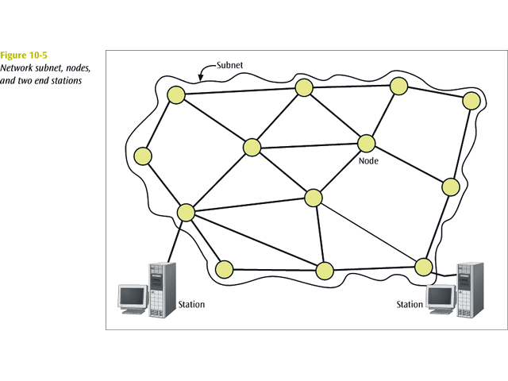
Switched Network

Slide 6

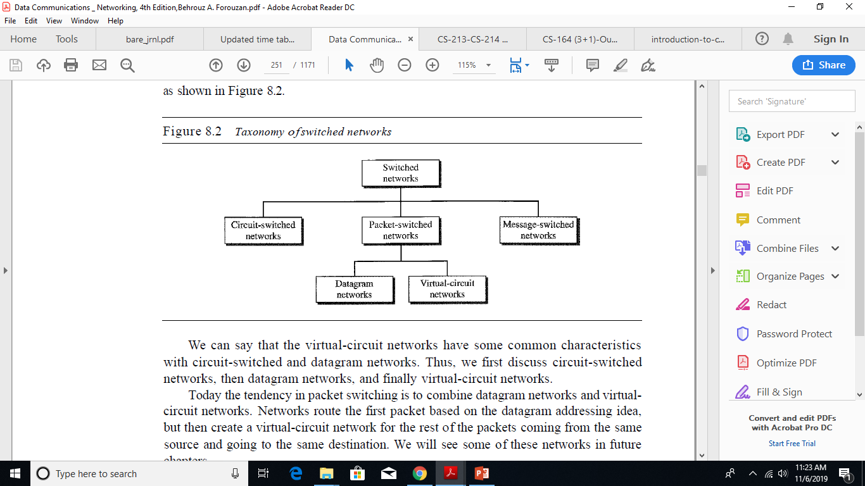

Slide 7

Circuit Switched Network
Circuit switched network - a network in which a dedicated circuit is established between sender and receiver and all data passes over this circuit.
The telephone system is a common example.
The connection is dedicated until one party or another terminates the connection.

Slide 8

Circuit Switching
Switching at the physical layer in the traditional telephone network uses
the circuit-switching approach.

Slide 9
Circuit Switching
Dedicated communication path between two stations
Three phases
  Establish
  Transfer
  Disconnect
Must have switching capacity and channel capacity to establish connection
Must have intelligence to work out routing

Slide 10
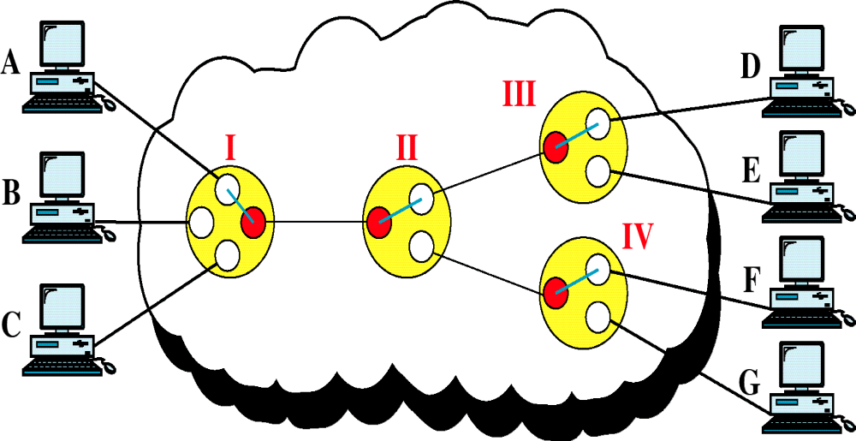
Circuit Switched Networks

Slide 11
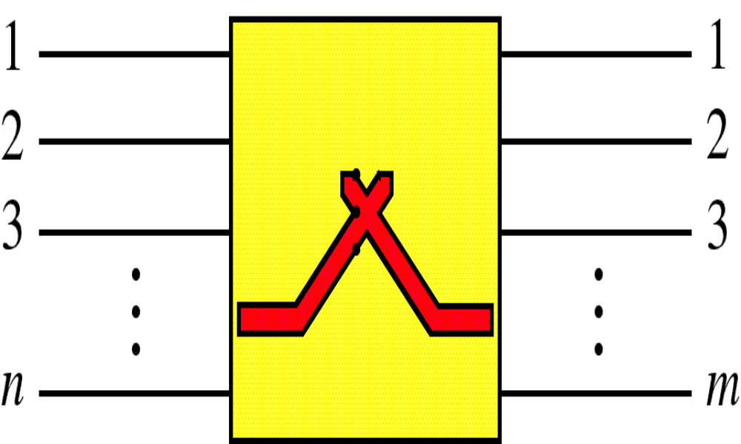
Switch

Slide 12
Circuit Switching Applications
Inefficient
  Channel capacity dedicated for duration of connection
  If no data, capacity wasted
Set up (connection) takes time
Once connected, transfer is transparent
Developed for voice traffic (phone)

Slide 13
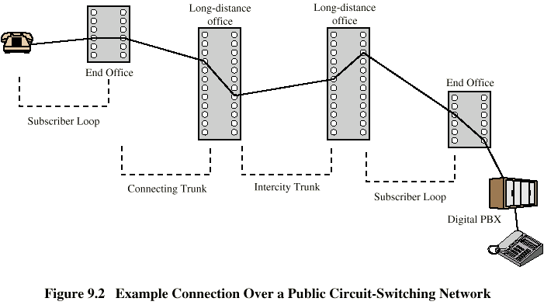
Public Circuit Switched Network

Slide 14
Blocking or Non-blocking
Blocking
  A network is unable to connect stations because all paths are in use
  A blocking network allows this
  Used on voice systems
    Short duration calls
Non-blocking
  Permits all stations to connect (in pairs) at once
  Used for some data connections

Slide 15
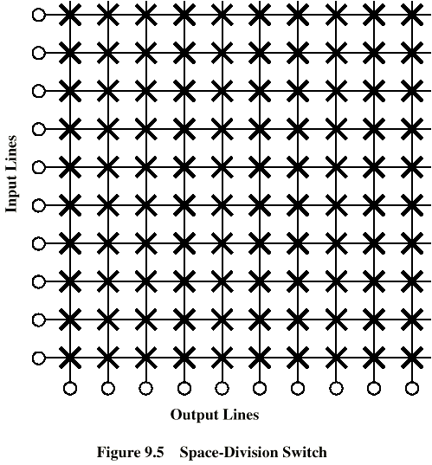
Crossbar Matrix

Slide 16
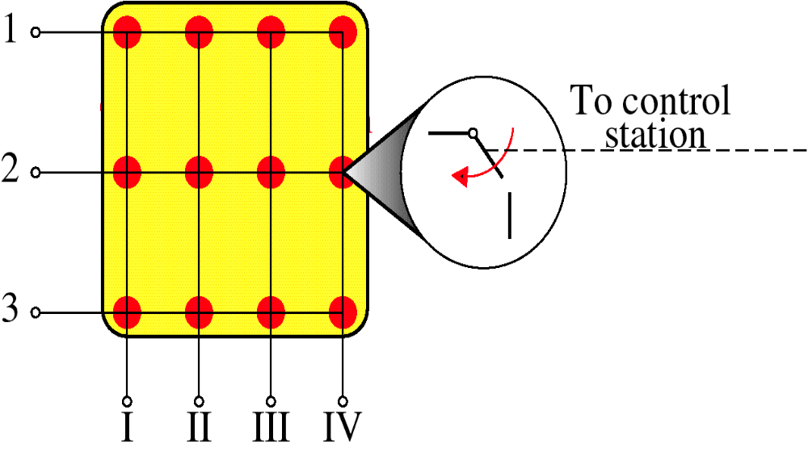
Crossbar Switch

Slide 17
Multistage Switch
Reduced number of crosspoints
More than one path through network
  Increased reliability
More complex control
May be blocking

Slide 18
Shortcoming of Circuit Switching Technique
Circuit switching designed for voice
  Resources dedicated to a particular call
  Inefficient approach (for data traffic)
    Much of the time a data connection is idle
  Constant Data rate
    Both ends must operate at the same rate

Slide 19
Packet Switching
Data transmitted in small packets
  Longer messages split into series of packets
  Each packet contains a portion of user data plus some control info
Control info
  Routing (addressing) info
Packets are received, stored briefly (buffered) and past on to the next node
  Store and forward
In a packet-switched network, there is no resource reservation; resources are allocated on demand.

Slide 20
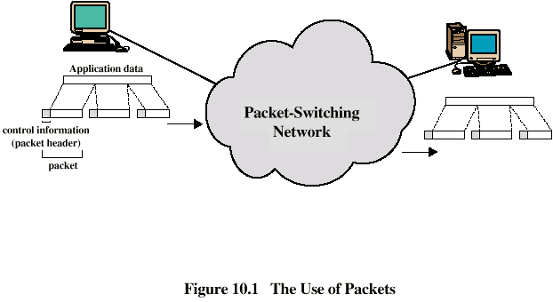
Use of Packets

Slide 21
Advantages
Line efficiency
  Single node to node link can be shared by many packets over time
  Packets queued and transmitted as fast as possible
Data rate conversion
  Each station connects to the local node at its own speed
  Nodes buffer data if required to equalize rates
Packets are accepted even when network is busy
  Delivery may slow down
Priorities can be used

Slide 22
Switching Technique
Packet switched network - a network in which all data messages are transmitted using short packages (typically size is not more than 1000 bytes), called packets.
More efficient use of a telecommunications line since packets from multiple sources can share the medium.
Station breaks long message into packets
Packets sent one at a time to the network
Packets handled in two ways
  Datagram
  Virtual circuit

Slide 23
Datagram
One form of packet switched network is the datagram. With a datagram, each packet is on its own and may follow its own path.
Each packet treated independently
Packets can take any practical route
Packets may arrive out of order
Packets may go missing
Up to receiver to re-order packets and recover from missing packets

Slide 24

Datagram Approach

Slide 25

Routing table in a datagram network
A switch in a datagram network uses a routing table that is based on the destination address.
The destination address in the header of a packet in a datagram network remains the same during the entire journey of the packet.

Slide 26

Delay in a Datagram Network
Switching in the Internet is done by using the datagram approach to packet switching at the network layer.

Slide 27

VIRTUAL-CIRCUIT NETWORKS
A virtual-circuit network is a cross between a circuit-switched network and a datagram network. It has some characteristics of both.

Slide 28
Virtual Circuit
Virtual circuit packet switched network create a logical path through the subnet and all packets from one connection follow this path.
Preplanned route established before any packets sent
Call request and call accept packets establish connection (handshake)
Each packet contains a virtual circuit identifier instead of destination address
No routing decisions required for each packet
Clear request to drop circuit
Not a dedicated path

Slide 29


Virtual-circuit identifier
&
Switch and tables in a virtual-circuit network

Slide 30

Source-to-destination data transfer in a virtual-circuit network
In virtual-circuit switching, all packets belonging to the same source and destination travel the same path; but the packets may arrive at the destination with different delays
if resource allocation is on demand.

Slide 31

Delay in a virtual-circuit network
Switching at the data link layer in a switched WAN is normally implemented by using virtual-circuit techniques.

Slide 32
Virtual Circuits vs. Datagram
Virtual Circuits Approach
  Network can provide sequencing and error control
  Packets are forwarded more quickly
    No routing decisions to make
  Less reliable
    Loss of a node looses all circuits through that node
Datagram Approach
  No call setup phase
    Better if few packets
  More flexible
    Routing can be used to avoid congested parts of the network
  More reliable
    If a node fails, subsequent packets may find an alternate route that bypass that node

Slide 33
Circuit Switching vs. Virtual Circuits
Path
  A dedicated path is established between two devices for the duration of session.
Reserved Resources
  The link (multiplexed / not multiplexed) that makes the path are dedicated, and cannot be used by other connections
The entire information is to be transmitted at a constant data rate.
Route
  No dedicated path is established. Only a route is defined. Each switch creates an entry in its routing table for the duration of virtual circuit
Shared Links
  The link that makes a route can be shard by other connections
Each packet follows the same route to reach the destination

Slide 34
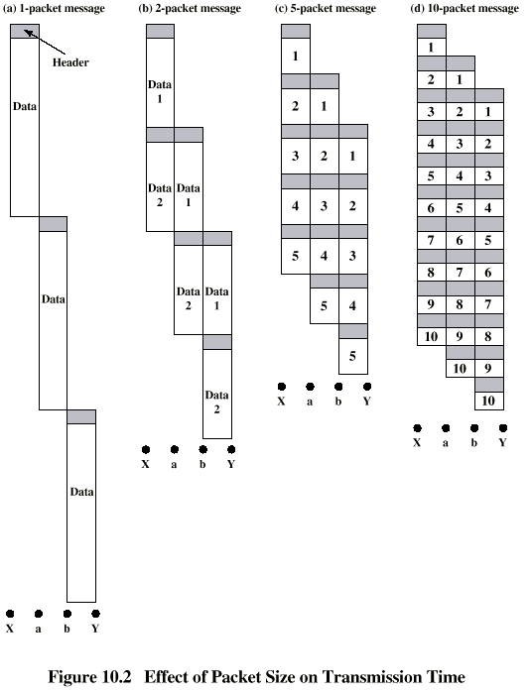
Effect of Packet Size on Transmission Time

